Slide 1
Transforming Skilled Nursing Facilities Through the Effective Use of Telemedicine HHS/CMS/ORD and Adam Sholar / North Carolina Health Care Facilities Association (NCHFA)
May 7, 2018
9:00 AM
Sam Nunn Atlanta Federal Center
61 Forsyth St. SW, Suite 4T20
Atlanta, GA 30303
John Whitman, MBA, NHA
The TRECS Institute

Slide 2
Meet Gertie

Slide 3
Today’s Objectives
Telemedicine in Skilled Nursing Facilities
CMS/AHCA Telemedicine Grant
Key Findings
Key Recommendations
Telemedicine Expansion to include Rural SNFs

Slide 4
America’s Skilled Nursing Facilities
15,655 SNF’s in America
11,000+ Urban (70% +/-)
4,300+ Rural (30% +/-)
70% Medicaid
Physician presence in SNFs (limited at best)
Sporadic day time in most urban
2-3 hours per week/month in many rural facilities
Majority of care decisions made over the phone

Slide 5
Key Challenges For Skilled Nursing Facilities
Much sicker patients
Lower reimbursement
High staff turnover
Smaller pool of patients (hospital census is down)
Increased regulatory oversight and compliance pressure
Clinical outcomes matter – STAR ratings and $ penalties
Families and patients have increased expectations
Litigation concerns are always there
Clinicians are hard to find and no one wants to work after hours

Slide 6
“The Default Factor”
As a System, we lack the ability utilizing “phone medicine” to effectively differentiate which nursing home residents need to be sent to the hospital and which residents can and should remain and be cared for in the SNF!

Slide 7
The Negative Impact of the Default Factor
Retrospective reviews confirm that 60% to 70% of all SNF to hospital admissions are unnecessary
Average cost per admission = $10,000+
In addition to cost, admitting a vulnerable senior to the hospital when they don’t need to go … is
NOT QUALITY CARE!
Estimated cost to Medicare for these unnecessary admissions is estimated to be over $1 billion dollars a year

Slide 8
Documented Risks for Vulnerable Seniors Admitted to the Hospital
Increased morbidity
Increased confusion
Incontinence
Skin breakdown
More medications
Exposed to “hospital acquired” infections
And the added cost of responding to the risks that materialize!

Slide 9
How Can We Improve Care to America’s 1.4 Million Nursing Facility Residents?

Slide 10
We Can Transform America’s Skilled Nursing Industry
By Offering High Quality
Telemedicine Services
at the Resident’s Bedside Across America’s 15,000+ Skilled Care Facilities

Slide 11
What is “Telemedicine”
“The practice of medicine when the doctor and patient are widely separated using two-way voice and visual communication”
Means a lot of different things to a lot of people
Remote weight and blood pressure checks
Blood sugar levels
Cardiac monitoring
Basic primary care
Medication management
Rural emergency rooms
Ambulances

Slide 12
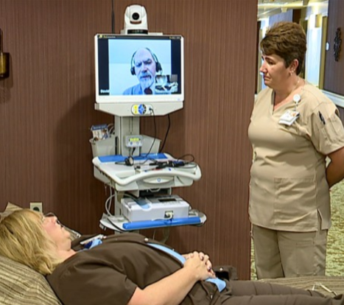
Telemedicine … The Ability To Differentiate Resident’s that Truly Need Hospitalization
Two way video interaction
Digitally enhanced stethoscope
Zoom camera
Otoscope
Pillow speaker & privacy phone
No log in/key board
Multi-hour battery life

Slide 13
How Most Telemedicine Services Work
1
2
3
4
The facility nurse calls and connects directly to a telemedicine physician or nurse practitioner.
The clinician examines the patient with the nurse through the telemedicine unit and treats in place when possible.
The clinician communicates with the attending on the episode and treatment plan and with the family
Full notes and orders are faxed securely to the nurse to update the patient’s record.

Slide 14
Telemedicine At Its Core
Improves access to care (Both urban and rural)
Cost effective way of focusing advanced and preventive care
Early Detection - Monitoring allows the SNF to focus on
residents before they require hospitalization
Virtual onsite care allows a limited workforce to be virtually present when needed (on demand)
This is how we can transform America’s Nursing Home Industry

Slide 15
Common Concerns about Telemedicine Voiced by SNF Physicians
Will this impact my billing?
Will this increase my liability exposure?
What’s to keep the virtual physician from “stealing” my patients?

Slide 16
Financial Case Study - Urban
One Year Study in New York City
350 bed facility
91 Avoided admissions in one year
$1.3 million dollars savings for Medicare
$132,000 additional revenue for SNF
Better Care for Seniors
Reduced System Costs
Increased Financial Performance for SNF

Slide 17
AHCA Grant No. GFA061
Virtual Physician Services in SNFs to Prevent Avoidable Hospital Admissions
Official start date: January 11, 2017
Four skilled nursing facilities included
Two virtual physician practices included
8 months of actual services

Slide 18
AHCA Grant No. GFA061 Final Four SNFs Selected

Slide 19
AHCA Grant No. GFA061
Study Goals
To evaluate the ability of virtual physician services to reduce avoidable SNF to hospital admissions and readmissions during off hours;
To evaluate the economic impact that avoidable admissions and readmissions can generate for Medicare, the participating SNFs and the state Medicaid Program;
To evaluate two separate virtual physician companies and identify key success characteristics SNFs should be looking for in seeking out a virtual physician organization to serve their residents;
To evaluate the four participating SNFs and identify key success characteristics that any SNF interested in establishing a virtual physician service can use to determine if their facility is a good candidate.

Slide 20
AHCA Grant No. GFA061 Findings from the Clinical Perspective
Ability to provide bedside evaluations (not phone medicine)
Ability to prevent unnecessary hospitalizations
Ability to utilize local ER when needed – but get resident back
Nursing staff noted improved clinical skills and confidence
Early detection of issues to prevent escalation
Very effective in securing Advanced Directives
Very effective at preventing “End of Life” hospital transfers
Overall - Better care for the resident

Slide 21
AHCA Grant No. GFA061 Findings – From the SNF Perspective
SNFs are turbulent organizations and difficult to organize
Critical to gain NHA and DON’s commitment
Critical to gain Medical Director’s commitment
Critical to gain nursing staff’s commitment
Need for regular discussions/review/education
Tremendous Marketing Differentiator
Hospitals respond well to reduced readmissions

Slide 22
AHCA Grant No. GFA061 Findings – Virtual Physician Companies
The quality of the physician is everything!
Must be clinically sound and comfortable with SNF care
Must be excellent communicators
With nursing staff
With primary care physicians
With families
Must answer the phone directly
Must keep good records
Must have plan for equipment breakdown (it is technology!)

Slide 23
AHCA Grant No. GFA061 Findings – From a Financial Perspective
Two of the four facilities were financially successful
Increased revenue exceeded cost of telemedicine service
Two of the four facilities were not financially successful
Increased revenue did not exceed cost of the service
Problems at both the SNF level and the virtual physician level
Medicare was financially successful in all facilities
Should Medicare be paying for telemedicine services?
Medicaid actually pays more when admission of Medicaid resident is prevented… Should Medicare be sharing savings with Medicaid?

Slide 24
Financial Impact on Medicare Spending
Avoided Admissions:
75 Total @ $10,000 per admission = $750,000
Avoided Medicare days
60% for average of 10 days @ $550/day = $247,500
Cost of “other issues” from acute stay
Highly vulnerable seniors being admitted = ????
Total Estimated Savings for Medicare = $997,500 (24 months)
Cost of Telemedicine Services = 114,000
Estimated Savings for Medicare = $ 883,500
Average Medicare Savings per Facility/Yr. = $110,437

Slide 25
Projected National Impact on Medicare if Virtual Physician Services were Reimbursed in all SNFs
Assumptions:
15,655 SNFs in America
Average savings per facility from study = $110,437
If 50% of America’s SNFs implemented telemedicine
with the same level of success as the four pilot SNFs,
Medicare would realize estimated savings of
$865 million dollars a year
Note: Other considerations have to be incorporated into final estimate (i.e., the fact that more residents would be seen more often (better care) with an increased cost to Medicare.

Slide 26
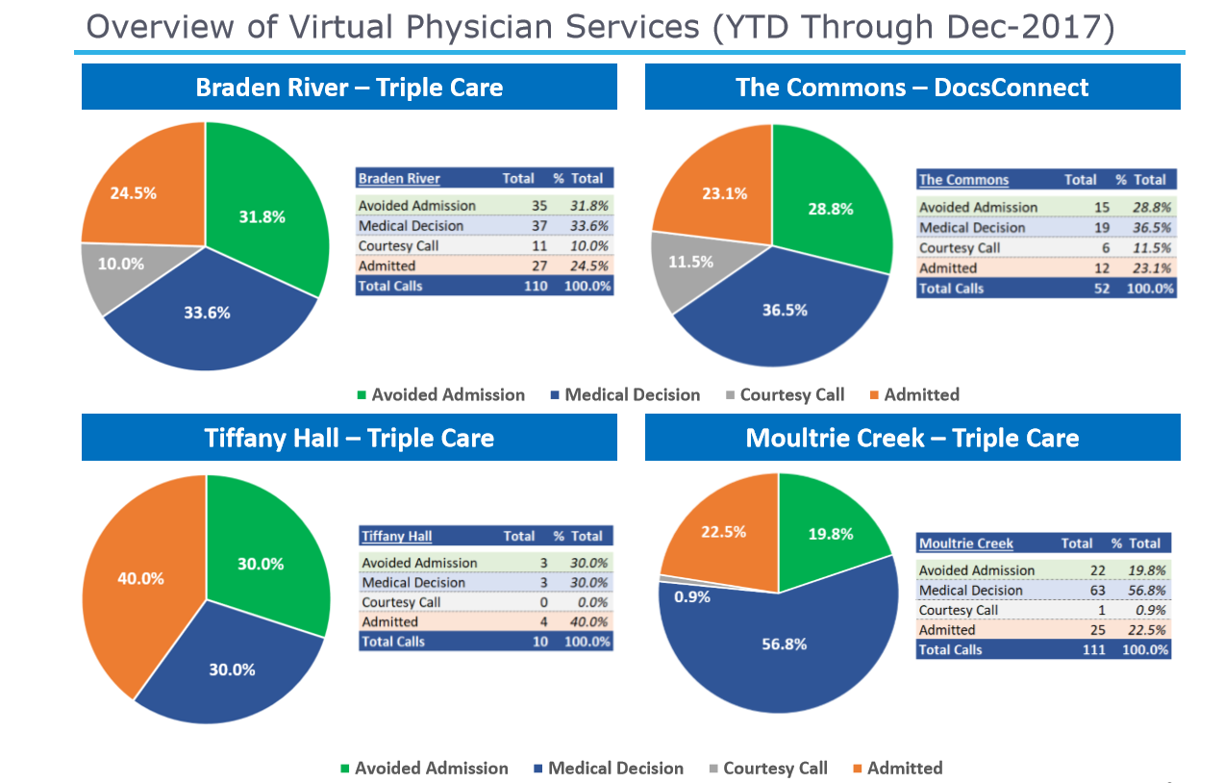

Slide 27
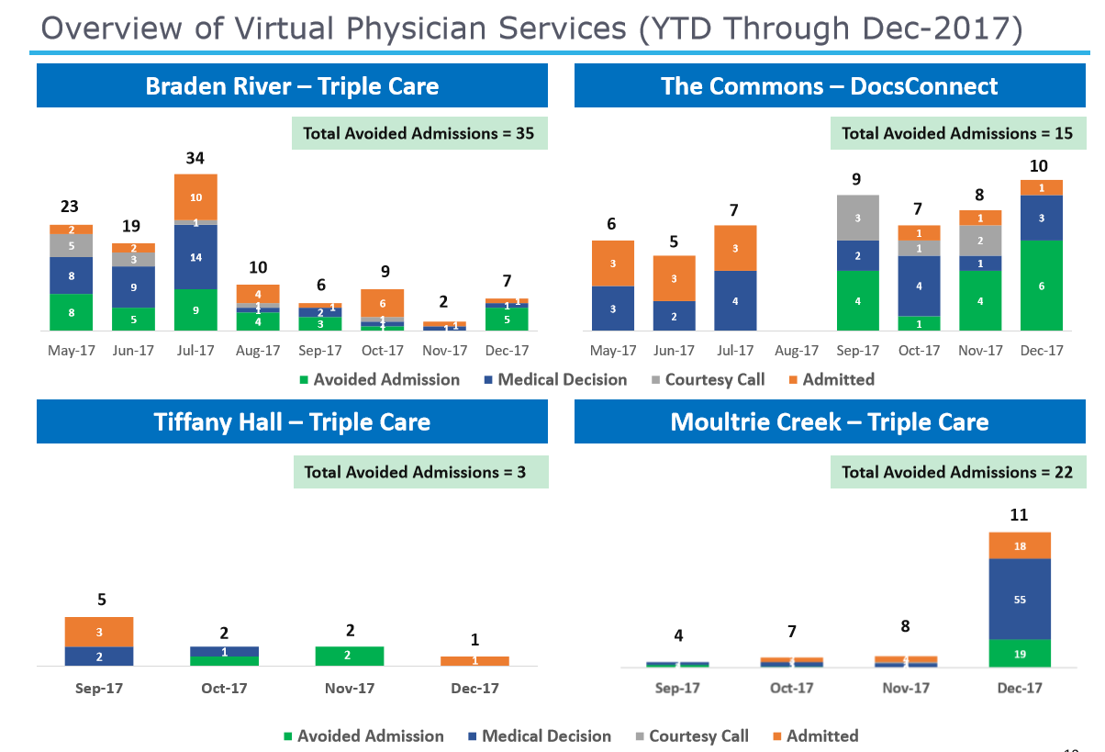

Slide 28
Final Thoughts On Study
Telemedicine is good for the resident – dramatically improves access to care when needed most
Telemedicine contributes significantly to Medicare savings
Telemedicine is not for every SNF – Certain critical success characteristics must be present
Not all physicians will buy into telemedicine …in the short term … but will need to in the long run
Not all virtual companies will be successful.. There are specific success characteristics they need

Slide 29
Preliminary Recommendations
Medicare should be reimbursing for telemedicine in urban and rural skilled nursing facilities
CMS should allow virtual telemedicine visits to meet the requirements for the 3 day evaluation requirement and 30/60 day review
CMS should consider allowing the requirement for medical director to be fulfilled with a virtual physician with once a month or as needed on site presence
State Nursing Home Associations should be encouraging their members, both urban and rural, to evaluate telemedicine for their residents
State nursing home associations should consider helping their members secure CMP Grants for telemedicine

Slide 30
Expanding Telemedicine to Rural Skilled Nursing Facilities

Slide 31
Why We Need Telemedicine in Rural Skilled Nursing Facilities
Availability of physicians in rural nursing facilities is often extremely limited (2-3 hours per week/month)
Availability of psychiatric services often limited or not available
Specialty consults are difficult to schedule:
Takes weeks or more to secure an appointment
Requires transport to specialist – miles away
Requires nursing staff member to accompany resident
Additional opportunities to improve care
Physiatrist for requesting additional coverage when needed

Slide 32
Rural Telemedicine Services Provide Access To:
Primary Care Services (Multi Specialty Medical Practice)
Nurse Practitioners and Specialty Clinicians
Daily Rounds when local physician not available
For changes in medical condition
9 hours per day and or 24/7 models
Behavioral/Psych Services
Scheduled
As needed including 24/7 emergency care
Specialty Consults Services
Scheduled and as needed
Dermatology, Cardiology, Pulmonology, Nephrology, Endocrinology, Physiatry and more
Wound Care & Continence Care

Slide 33
Rural “Primary Care” Services
Clinician available 9 hours a day to see patients on demand (8 am to 5 pm, Monday through Friday)
Daily Rounds (5 days per week) with facility’s nurses
Available on demand to see patients when there is an acute change in condition
Communicates and integrates with the attending
Communicates with families
Assists with Advanced Care Planning
Documents visits

Slide 34
Rural “Behavioral/Psych” Services
Monthly Behavioral Visits (or as often as clinically required)
Residents with:
Depression, Bipolar, Schizoaffective disorders
Dementia with behavioral manifestations
Medication De-escalation and monitoring
Behavioral – Milieu Management
Family Communication and Support
Acute change of condition and 24/7 support
Staff training and support
F Tag response

Slide 35
Rural “Consultative Specialists” Services
Providing Consultation via Telemedicine
Scheduled and Urgent Visits
Integrates with the attending
Communicates with the family
Provides consultative note
Dermatology | Gastroenterology
Cardiology | Endocrinology
Pulmonology | Urology
Infectious Disease | Neurology
Physiatry | Orthopedic Surgery

Slide 36
Common Telemedicine Episodes
Chief Complaints
Shortness of breath
Fever
Change in mental status
GI symptoms
Chest pain
Falls with injuries
Behavior changes
Common Diagnosis
CHF
Pneumonia
COPD
Hypovolemia and/or hypotension
Urosepsis

Slide 37
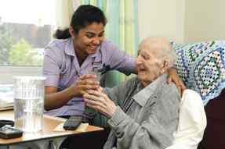
Clinical and Social Impact
Early Treatment of Conditions
Reduced Emergency Room Transfer
Reduced Hospitalizations
State Survey Assistance
Medication Stewardship
Advanced Care Planning
High Nurse Satisfaction
Onsite Experiential Nurse Training
High Patient and Family Satisfaction
High Attending Integration and Satisfaction

Slide 38
Other Benefits
Nursing Staff:
“When I call the doctor, he answers the phone!”
Increased skills and confidence level
Families:
Knowing Mom gets immediate care
Not going to the hospital
Physicians:
Gets my patients the care they need
Makes my day easier
Eliminates a lot of the “noise!”

Slide 39
Reimbursement
Rural
Reimbursement – for clinicians (Medicare Part B)
Originating Fee ($20 per visit) covers I.T. readiness
and equipment costs
Economics work because no net cost to SNF

Slide 40
Opportunities for Financial Impact
RUGS
Integrate with MDS nurse, Integrating with RTMS software
STAR Rating
Direct impact on return to hospital – Keeps beds filled and helps to grow census
Direct Impact on emergency room transfers.
Improved nursing staff skills and confidence
Significant Market Differentiator
Your own medical house staff
Better positioned for Shared Savings Agreements

Slide 41
Clinical Case Study
Notes:
-high utilization for some folks emerges from the friction between a patient’s personal values/beliefs and what the medical system is designed to deliver. This is exacerbated in cases where the patient is living in an institutional setting
-in this case, a resident with values/beliefs in homeopathic healing was in tension with the most recent medical system around her setup for allopathic healing, the result is often anxiety from feeling socially isolated as “crazy” which leads to vicious cycle of feeling of not being heard → increased anxiety → more seeking → etc
-medical strategy by good medical providers is to arrange for more frequent appointments to help forge provider/patient trust where the patient feels heard and the provider keeps tabs on when/where to utilize allopathic vs. non-allopathic interventions
-this is very challenging for residents living in rural institutionalized settings where they’re isolated from their medical provider → telehealth facilitates this by placing a medical provider in the building daily to meet both patient and medical systems needs here
-I’m not advocating for taking away any necessary allopathic assessments/interventions, I’m pointing out the issue that there is not a pill for every problem. Sometimes the right answer is simply to make sense of the situation for a patient, staff, family, etc. This requires time from the provider which telehealth facilitates. When the diversity of single person meets the standardization machine of our modern healthcare system bad things can happen

Slide 42
Clinical Case Study
Notes:
-high utilization for some folks emerges from the friction between a patient’s personal values/beliefs and what the medical system is designed to deliver. This is exacerbated in cases where the patient is living in an institutional setting
-in this case, a resident with values/beliefs in homeopathic healing was in tension with the most recent medical system around her setup for allopathic healing, the result is often anxiety from feeling socially isolated as “crazy” which leads to vicious cycle of feeling of not being heard → increased anxiety → more seeking → etc
-medical strategy by good medical providers is to arrange for more frequent appointments to help forge provider/patient trust where the patient feels heard and the provider keeps tabs on when/where to utilize allopathic vs. non-allopathic interventions
-this is very challenging for residents living in rural institutionalized settings where they’re isolated from their medical provider → telehealth facilitates this by placing a medical provider in the building daily to meet both patient and medical systems needs here
-I’m not advocating for taking away any necessary allopathic assessments/interventions, I’m pointing out the issue that there is not a pill for every problem. Sometimes the right answer is simply to make sense of the situation for a patient, staff, family, etc. This requires time from the provider which telehealth facilitates. When the diversity of single person meets the standardization machine of our modern healthcare system bad things can happen

Slide 43
Financial Case Study - Rural
 | Tapestry TeleHealth Visits to Three Rural SNFs
2018 | February | March | April | Total
 |  |  | (4/1 - 4/13)
Facility #1 (121 beds)
Primary Care Visits | 48 | 87 | 39 | 174
Psych Visits | 0 | 0 | 0 | 0
Specialty Consult Visits (1) | 0 | 0 | 12 | 12
Total Visits | 48 | 87 | 51 | 186
Facility #2 (112 beds)
Primary Care Visits | 2 | 19 | 16 | 37
Psych Visits | 0 | 0 | 0 | 0
Specialty Consult Visits | 0 | 0 | 0 | 0
Total Visits | 2 | 19 | 16 | 37
Facility #3 (68 beds)
High Risk Visits | 8 | 24 | 26 | 58
Psych Visits | 0 | 19 | 21 | 40
Specialty Consult Visits | 0 | 0 | 0 | 0
Total Visits | 8 | 43 | 47 | 98

Slide 44
Financial Case Study – Rural (continued) 14 patients classified as “Avoided Hospitalization” 3 billing days per resident saved = 42 billable days
Average daily billing at $275 = $11,550
Plus avoided transportation/staff costs by providing 12 Specialty Consults at resident’s bed side

Slide 45
Proven Multispecialty Physician Practices Offering Telemedicine
Tapestry TeleHealth, Inc.
www.tapestry.care Rural SNFs
David Chess, MD
203-521-4730
TripleCare, Inc.
www.triple.care Urban SNFs
Mary Jo Gorman, MD
855-376-3669

Slide 46
Thank You!
Please feel free to contact me if you have any questions about the potential of implementing Telemedicine in skilled nursing facilities!
John Whitman, MBA, NHA
Executive Director
The TRECS Institute
johnwhitman@theTRECSinstitute.org
484-557-6980

